Slide 1
What’s Up?
Highlighting the Near
and Deep Sky
April 1 - 30, 2024

Slide 2
Moon Phases and Apsides
April 2024
Moon Phases:
Mon., 1st – Last Quarter (Left half-illuminated Moon rises late)
Mon., 8th – New Moon (Moon out of view overnight)
Mon., 15th – First Quarter (Right half-illuminated Moon sets late)
Tue., 23rd – Full Moon (Fully-illuminated Moon in view all night)
Apsides:
Perigee: Sun., 7th – Distance 222,980 mi., diameter 33′ 18″.
Apogee: Fr1., 19th – Distance 252,042 mi., diameter 29′ 28″. (11.5% narrower than on the 10th).

Slide 3
Viewing Solar System Planets
April 2024
Body | April 1st |  | April 30th
 | Rise | Set | Rise | Set
Sun | 07:02 | 19:42 | 06:23 | 20:08
Twilight | Begins 05:33 | Ends 21:11 | Begins 04:45 | Ends 21:46
Mercury | 07:27 | 20:56 | 05:31 | 18:04
Venus | 06:28 | 18:12 | 06:03 | 19:13
Mars | 05:42 | 16:45 | 04:44 | 16:41
Jupiter | 08:42 | 22:30 | 07:08 | 21:08
Saturn | 06:00 | 17:16 | 04:14 | 15:37
Uranus | 08:50 | 22:48 | 07:01 | 21:02
Neptune | 06:34 | 18:27 | 04:42 | 16:38
Bold = Well placed for evening viewing Blue italicized times = next day // Red italicized times = previous day
The Sun and Planets – April 2024

Slide 4
Celestial Events
April 2024
Mon., 8th – Solar Eclipse. U.S. path of totality spans Texas to Maine. Local view is a partial eclipse, with 88% the maximum covered for Roanoke.
Mon., 8th – Comet 12/P Pons-Brooks, about 25° from the Sun during the eclipse, has a chance – if an outburst occurs – of being visible during totality of the eclipse.
Wed., 10th – Early risers with a clear ESE horizon may catch Mars and Saturn, less than ½° apart, rising an hour before sunrise.
Fri., 14th, 11:00 PM – The Equation of Time is 0. One of the 4 instants during the year when solar (sundials) and civil time (clocks) agree on the time.
Thu., 18th – Astronomically, the Sun enters Aries. But in non-sidereal forms of astrology, it will enter Taurus in less than 24 hours.
Sun./Mon., 21st/22nd – Annual Lyrid Meteor Shower. Typically about 18 meteors per hour. Unfortunately, the Moon is nearly full.

Slide 5
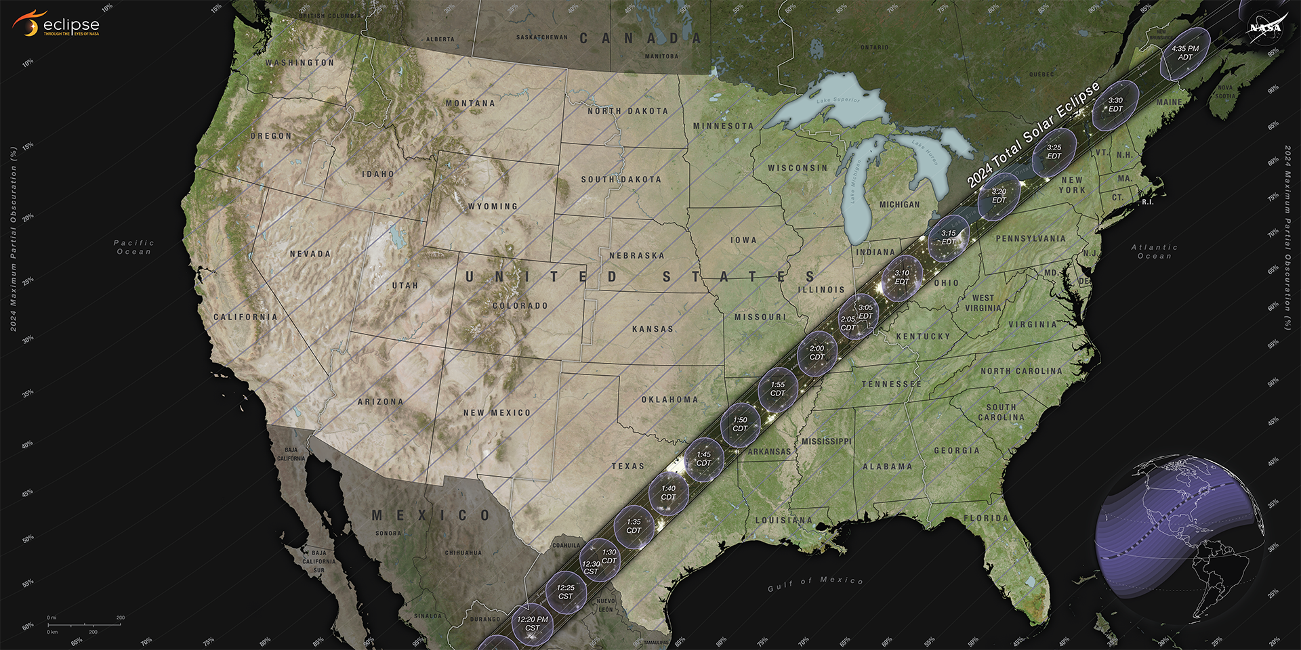
April 8, 2024, Total Solar Eclipse
Path of Totality
Longest Totality
Nazas, Durango, Mexico
4 min., 28.13 sec

Slide 6
1
Eclipse Phases
For Roanoke
2
1 – Begins 13:57:46
2 – Max. 15:15:07
(88% obscured)
3 – Ends 16:29:03
3

Slide 7
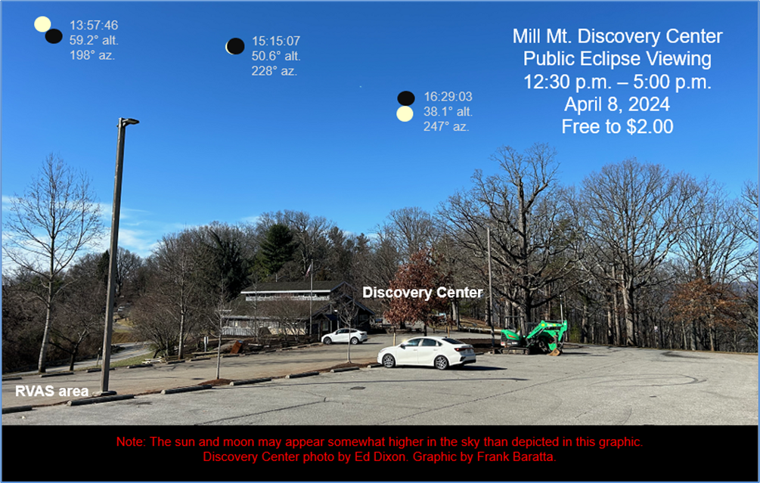

Slide 8
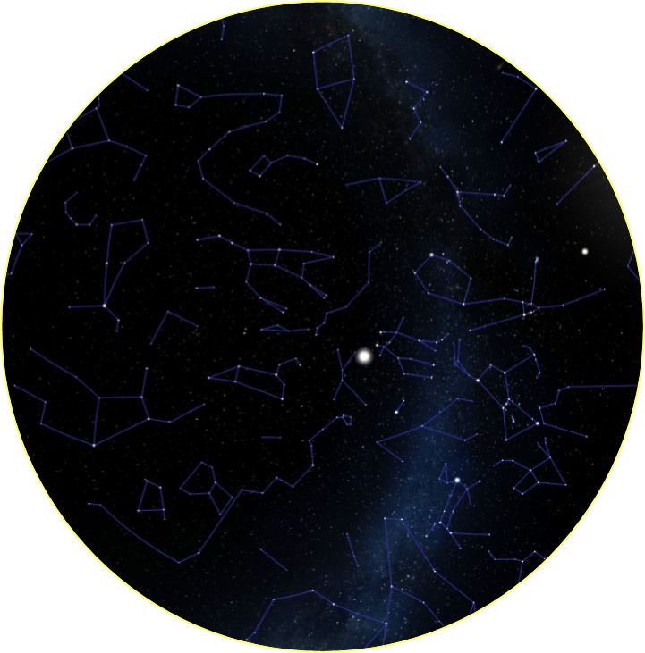
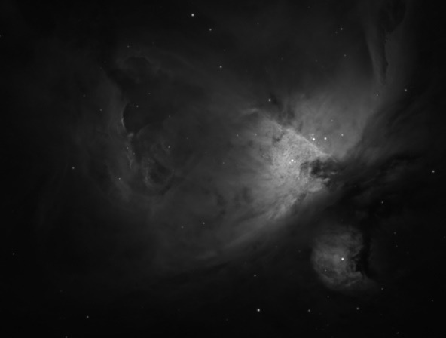
N
Apr. 15th, 8:58 p.m.
(30 min. before full darkness)
Little
Dipper
Polaris
Big
Dipper
Uranus
Jupiter
E
Spring
Z
Winter
W
M42
Fish’s
Mouth
Moon
Trapezium
Cluster
S

Slide 9
April Observing Suggestions
Naked Eye: Observe the total eclipse, which will be partial in our region. Do not view the sun without proper eye protection. Doing so risks immediate and permanent eye damage.
Binocular: Locate Orion and view the Orion nebula (Messier 42 [M42]), located below Orion’s belt.
Telescope: Locate the Orion nebula and the “fish’s mouth.” Look near the inner tip of the mouth to find the Trapezium: the four brightest stars in this cluster, estimated to comprise over 1,000 stars. You may even notice a fifth star!

Slide 10
Questions
???

