Slide 1
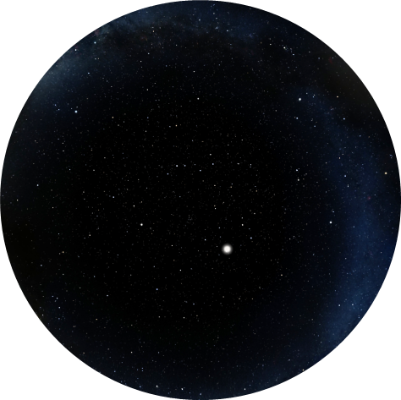
What’s Up?
Highlighting the Near
and Deep Sky
May 1 - 31, 2024

Slide 2
Moon Phases and Apsides
May 2024
Moon Phases:
Wed., 1st – Last Quarter (Left half-illuminated Moon rises late)
Tue., 7th – New Moon (Moon out of view overnight)
Wed., 15th – First Quarter (Right half-illuminated Moon sets late)
Thu., 23rd – Full Moon (Fully-illuminated Moon in view all night)
Thu., 30th – Last Quarter (Left half-illuminated Moon rises late)
Apsides:
Perigee: Sun., 5th – Distance 225,660 mi., diameter 32′ 54″.
Apogee: Fr1., 17th – Distance 251,431 mi., diameter 29′ 32″. (10.2% narrower than on the 5th).

Slide 3
Viewing Solar System Planets
May 2024
Body | May 1st |  | May 31st
 | Rise | Set | Rise | Set
Sun | 06:22 | 20:09 | 05:58 | 20:33
Twilight | Begins 04:44 | Ends 21:47 | Begins 04:08 | Ends 22:24
Mercury | 05:29 | 18:01 | 05:10 | 19:05
Venus | 06:02 | 19:16 | 05:55 | 20:21
Mars | 04:42 | 16:41 | 03:41 | 16:34
Jupiter | 07:05 | 21:06 | 05:30 | 19:42
Saturn | 04:10 | 15:33 | 02:18 | 13:45
Uranus | 06:57 | 20:58 | 05:05 | 19:09
Neptune | 04:38 | 16:34 | 02:42 | 14:39
Bold = Well placed for evening viewing Blue italicized times = next day // Red italicized times = previous day
The Sun and Planets – May 2024

Slide 4
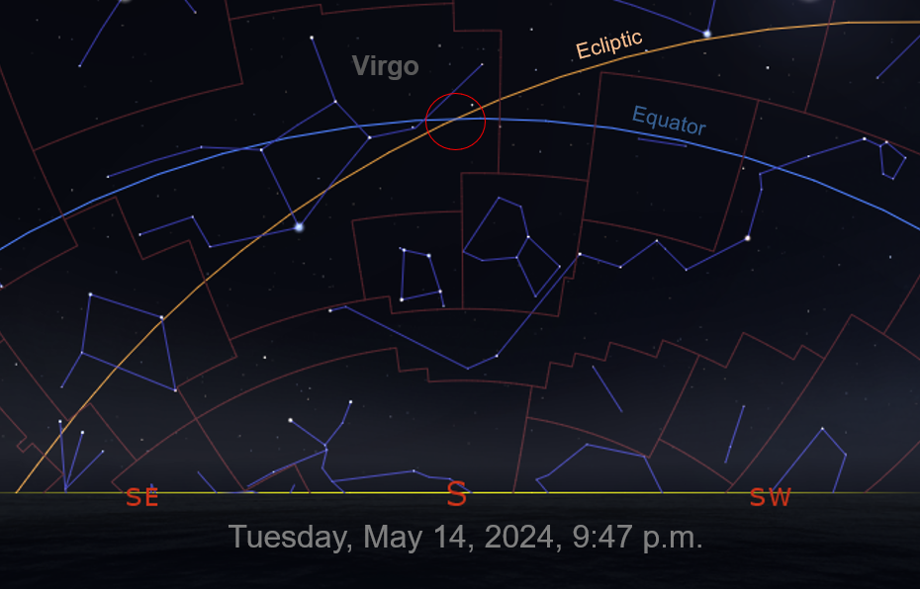
Celestial Events
May 2024
Sun., 5th – Annual Eta Aquarid meteors peak at 5 p.m. Debris from outbound Halley’s Comet. 15–20 per hour. Best viewed pre-dawn hours on 5th and 6th.
Wed., 8th – Challenge Binocular/Telescopic Observation: 1% illuminated Moon less than 1° from Pleiades 5° above NW horizon 30 min. after sunset.
Tue., 14th – At 9:47 p.m., view intersection of the celestial equator and the ecliptic, marking where the Sun will be on the autumnal equinox.
Sat., 18th – Asteroid 2 Pallas at opposition. Excellent time to track the second discovered and third largest asteroid for the next few weeks.
Fri., 31st – Early risers can view the waning crescent Moon 28° high in the SE pre-dawn sky, about 1.25° from Saturn.

Slide 5
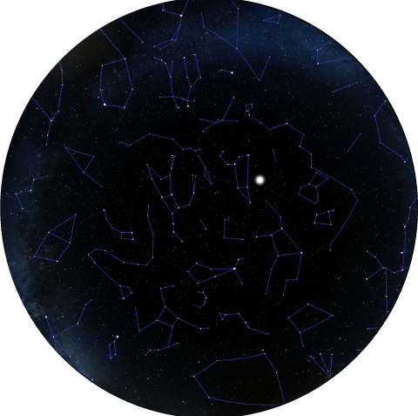
W
May 16th, 9:38 p.m.
(30 min. before full darkness)
Moon
N
S
Little
Dipper
Big
Dipper
E

Slide 6
Questions
???

